Slide 1
Source Code Layering
By Anthony Gilliam

Slide 2

What is code layering?
Dividing specific processes of an application into separate lateral segments
Derived from N-Tier Architecture
A layer is different from a tier

Slide 3
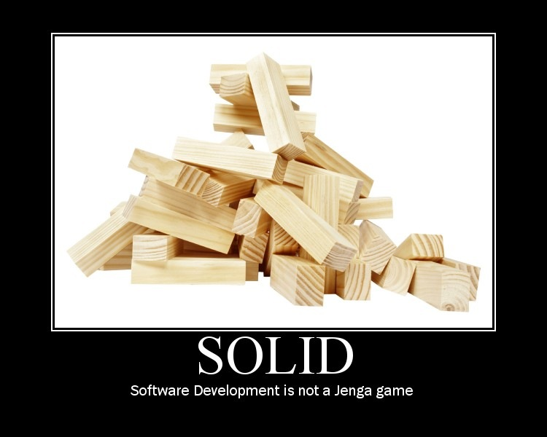
Solid Principles
S.O.L.I.D. object-orientated design
Single Responsibility Principle
Liskov’s Substitution Principle
Interface Segregation Principle

Slide 4

How Can Layers Help My Application?
STOP SPAGHETTI CODE!!!
Code coordinate system
Happy Developers

Slide 5
Simple Layer Architecture
Domain Layer
Repository Layer
Service Layer
View Layer

Slide 6
Advanced layering architecture
MVVM design pattern
View Model layer
Mapping layer
Controller layer
View layer

Slide 7

Summary
The purpose of layers in code
The basic layers
How do I know when to create a layer?
Use layers to simplify code, not complicate it!

